Slide 1
Engineering Research Team
(Part of LLE grant)
Summer 2024 Dawson Tooker
students: Ryan McDonald
Jacob Rosario

Slide 2
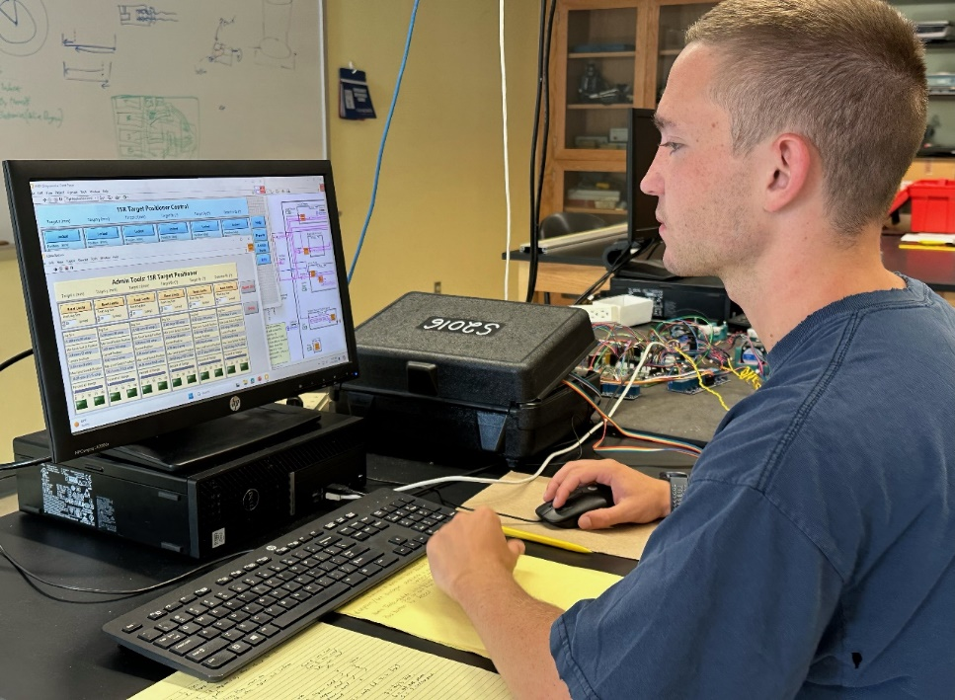
Engineering Research Team
(Part of LLE grant)
Dawson is testing and debugging LabVIEW code.

Slide 3
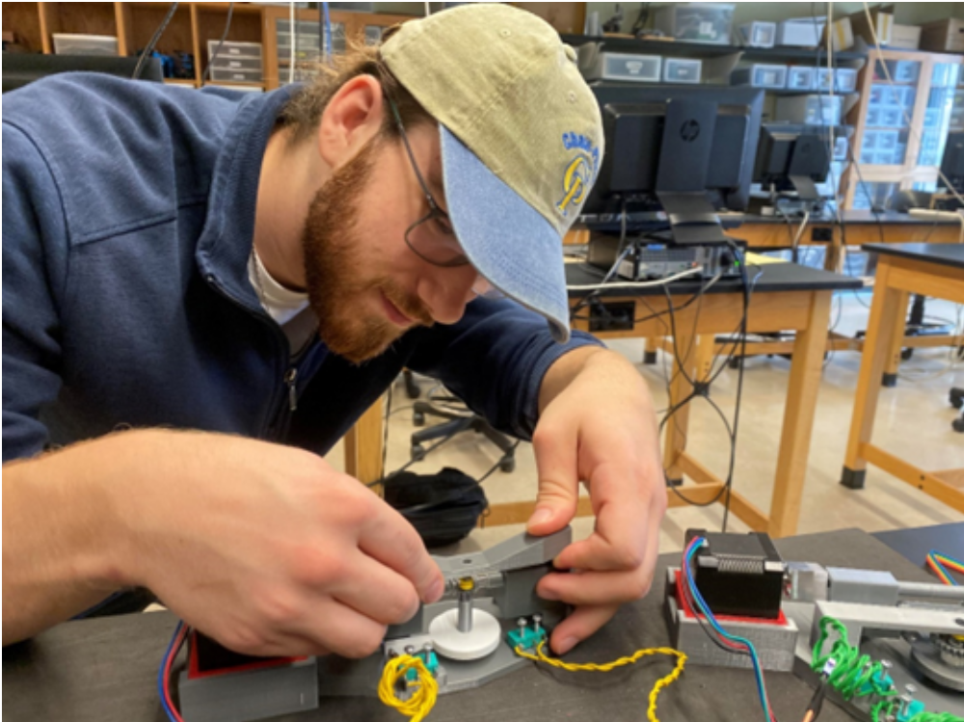
Engineering Research Team
(Part of LLE grant)
Ryan is assembling a motor to be used for testing and debugging. Ryan 3D printed the housing that holds the motor and switches.

Slide 4
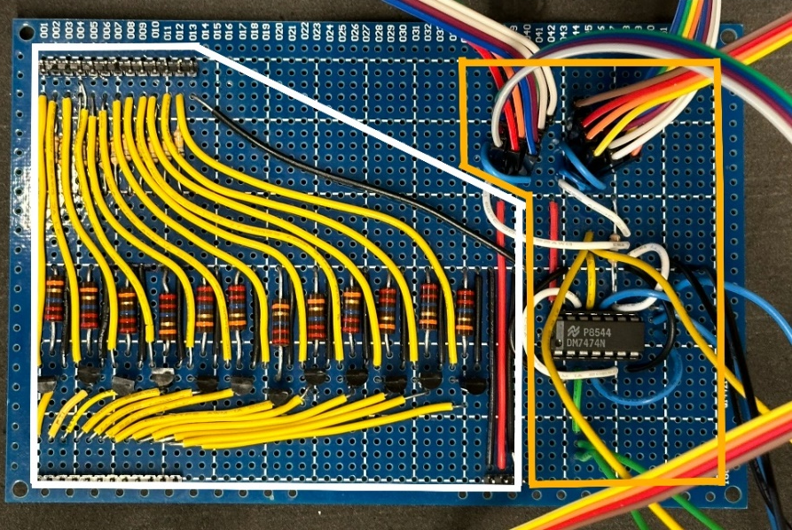
Engineering Research Team
(Part of LLE grant)
Why don’t I have an actual photo of Jacob soldering this control circuit?
Answer: aliens.

Slide 5
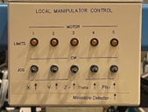
Engineering Research Team
(Part of LLE grant)
“Big” Picture: this control panel is attached to the 15R end station in the acceleration.
We want to replace it…

Slide 6
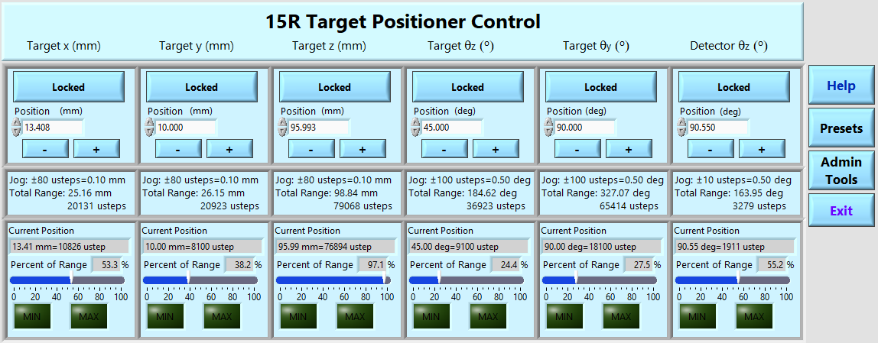
Engineering Research Team
(Part of LLE grant)
The new system:
Can be operated remotely
Provides feedback so the user knows what’s actually happening.
Provides accuracy & repeatability.

Slide 7
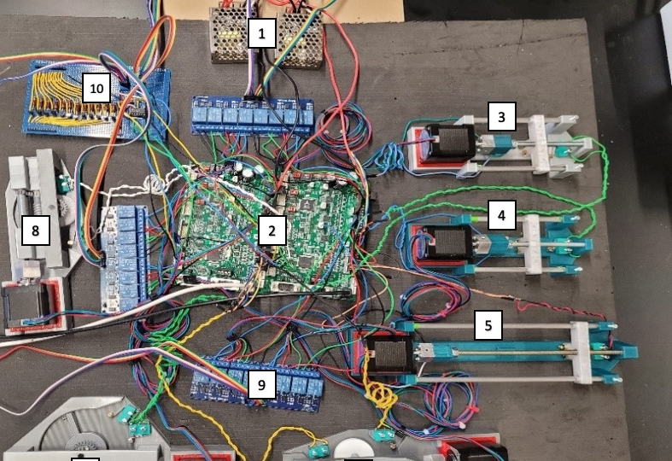
Engineering Research Team
(Part of LLE grant)
We’ve tested this simulated version, and we think it works.
Next step: connecting to the actual hardware and seeing if it really works.

